Slide 1

Chapter 19
Network Layer:
Logical Addressing
Copyright © The McGraw-Hill Companies, Inc. Permission required for reproduction or display.

Slide 2
19-1 IPv4 ADDRESSES
An IPv4 address is a 32-bit address that uniquely and universally defines the connection of a device (for example, a computer or a router) to the Internet.
Topics discussed in this section:
Address Space Notations
Classful Addressing
Classless Addressing
Network Address Translation (NAT)

Slide 3

Note
An IPv4 address is 32 bits long.

Slide 4
Note
The IPv4 addresses are unique and universal.

Slide 5
Note
The address space of IPv4 is 2³² or 4,294,967,296.

Slide 6
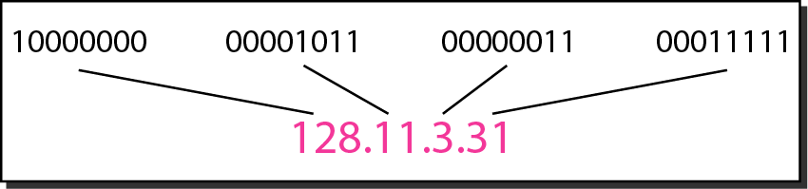
Figure 19.1 Dotted-decimal notation and binary notation for an IPv4 address

Slide 7
Note
Numbering systems are reviewed in Appendix B.

Slide 8
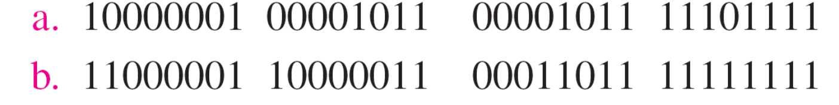
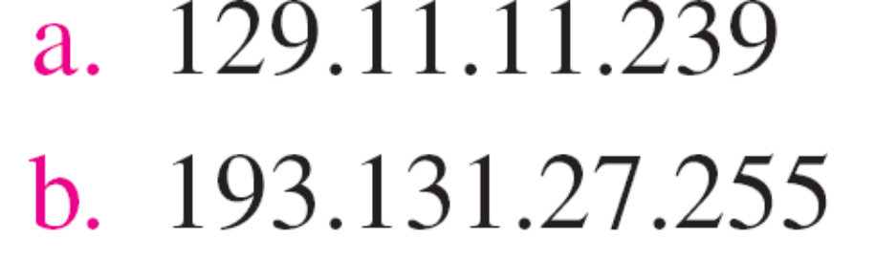
Example 19.1
Change the following IPv4 addresses from binary notation to dotted-decimal notation.
Solution
We replace each group of 8 bits with its equivalent decimal number (see Appendix B) and add dots for separation.

Slide 9
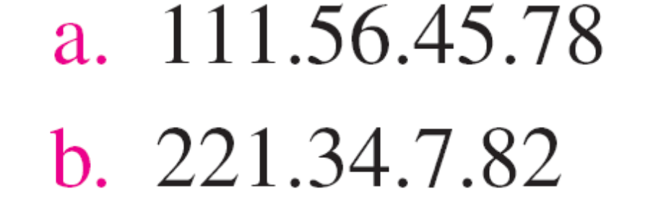
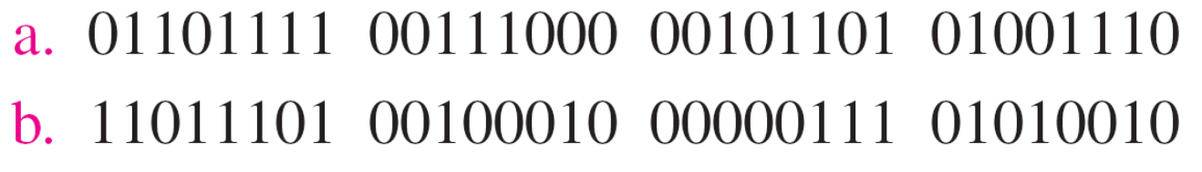
Example 19.2
Change the following IPv4 addresses from dotted-decimal notation to binary notation.
Solution
We replace each decimal number with its binary equivalent (see Appendix B).

Slide 10
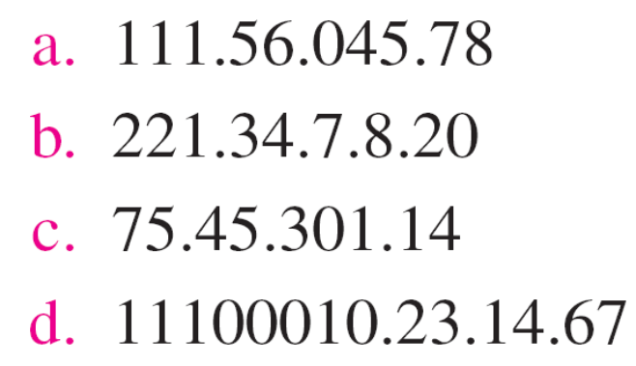
Example 19.3
Find the error, if any, in the following IPv4 addresses.
Solution
a. There must be no leading zero (045).
b. There can be no more than four numbers.
c. Each number needs to be less than or equal to 255.
d. A mixture of binary notation and dotted-decimal notation is not allowed.

Slide 11
Note
In classful addressing, the address space is divided into five classes:
A, B, C, D, and E.

Slide 12
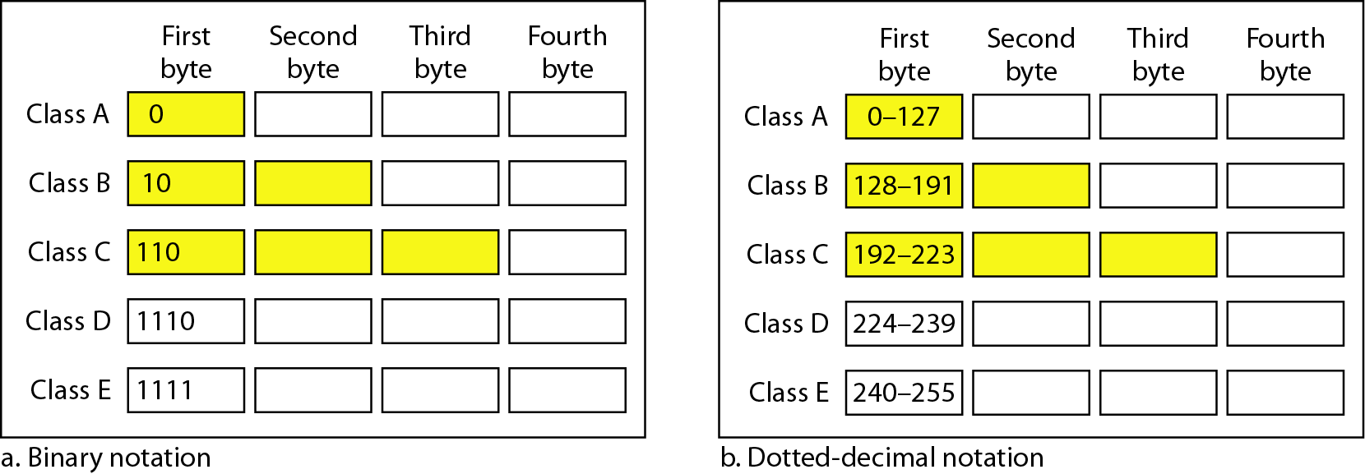
Figure 19.2 Finding the classes in binary and dotted-decimal notation

Slide 13
Example 19.4
Find the class of each address.
a. 00000001 00001011 00001011 11101111
b. 11000001 10000011 00011011 11111111
c. 14.23.120.8
d. 252.5.15.111
Solution
a. The first bit is 0. This is a class A address.
b. The first 2 bits are 1; the third bit is 0. This is a class C address.
c. The first byte is 14; the class is A.
d. The first byte is 252; the class is E.

Slide 14
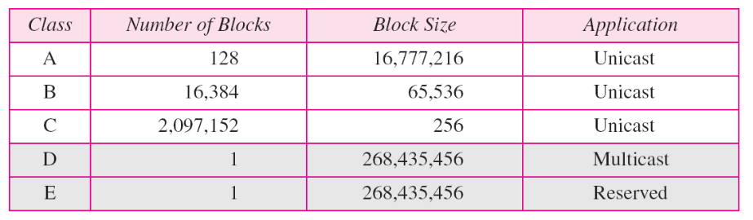
Table 19.1 Number of blocks and block size in classful IPv4 addressing

Slide 15
Note
In classful addressing, a large part of the available addresses were wasted.

Slide 16
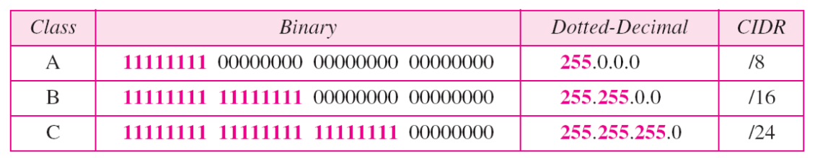
Table 19.2 Default masks for classful addressing

Slide 17
Note
Classful addressing, which is almost obsolete, is replaced with classless addressing.

Slide 18
Note
In IPv4 addressing, a block of addresses can be defined as
x.y.z.t /n
in which x.y.z.t defines one of the addresses and the /n defines the mask.

Slide 19
Note
The first address in the block can be found by setting the rightmost 32 − n bits to 0s.

Slide 20
Example 19.6
A block of addresses is granted to a small organization. We know that one of the addresses is 205.16.37.39/28. What is the first address in the block?
Solution
The binary representation of the given address is
11001101 00010000 00100101 00100111
If we set 32−28 rightmost bits to 0, we get
11001101 00010000 00100101 0010000
or 205.16.37.32.
This is actually the block shown in Figure 19.3.

Slide 21
Note
The last address in the block can be found by setting the rightmost 32 − n bits to 1s.

Slide 22
Example 19.7
Find the last address for the block in Example 19.6.
Solution
The binary representation of the given address is
11001101 00010000 00100101 00100111
If we set 32 − 28 rightmost bits to 1, we get
11001101 00010000 00100101 00101111
or
205.16.37.47
This is actually the block shown in Figure 19.3.

Slide 23
Example 19.10
An ISP is granted a block of addresses starting with 190.100.0.0/16 (65,536 addresses). The ISP needs to distribute these addresses to three groups of customers as follows:
a. The first group has 64 customers; each needs 256 addresses.
b. The second group has 128 customers; each needs 128 addresses.
c. The third group has 128 customers; each needs 64 addresses.
Design the subblocks and find out how many addresses are still available after these allocations.

Slide 24
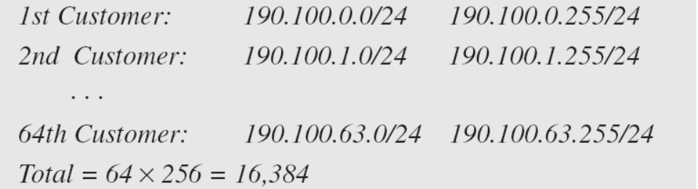
Example 19.10 (continued)
Solution
Figure 19.9 shows the situation.
Group 1
For this group, each customer needs 256 addresses. This means that 8 (log2 256) bits are needed to define each host. The prefix length is then 32 − 8 = 24. The addresses are

Slide 25
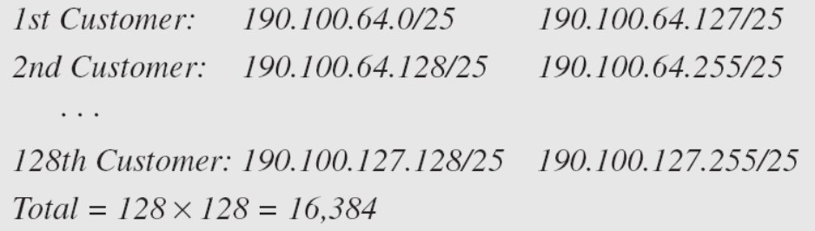
Example 19.10 (continued)
Group 2
For this group, each customer needs 128 addresses. This means that 7 (log2 128) bits are needed to define each host. The prefix length is then 32 − 7 = 25. The addresses are

Slide 26
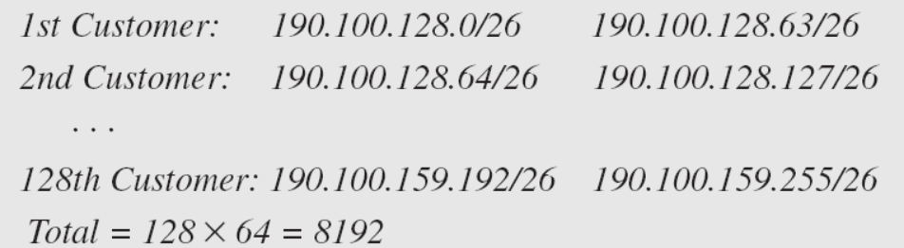
Example 19.10 (continued)
Group 3
For this group, each customer needs 64 addresses. This means that 6 (log₂64) bits are needed to each host. The prefix length is then 32 − 6 = 26. The addresses are
Number of granted addresses to the ISP: 65,536
Number of allocated addresses by the ISP: 40,960
Number of available addresses: 24,576

Slide 27
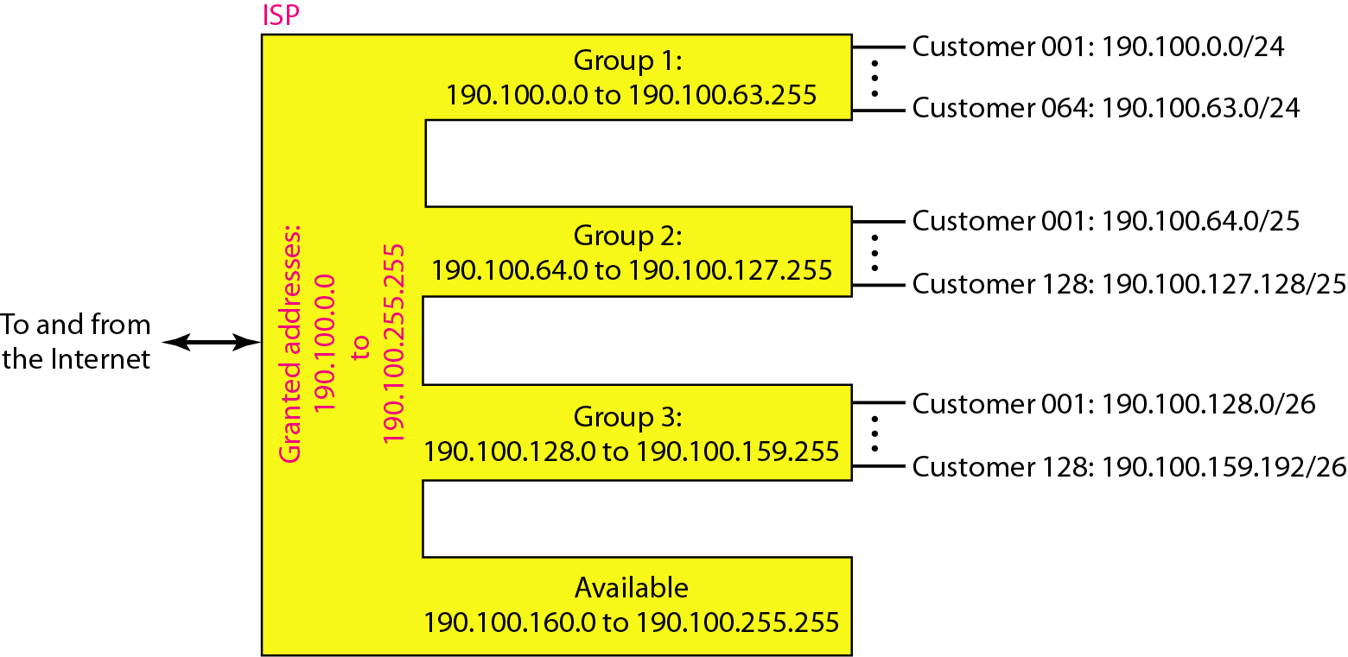
Figure 19.9 An example of address allocation and distribution by an ISP

Slide 28
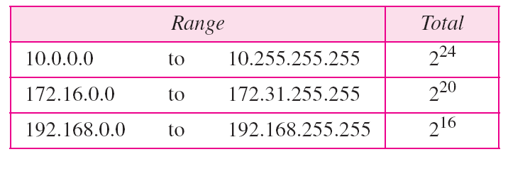
Table 19.3 Addresses for private networks

Slide 29
19-2 IPv6 ADDRESSES
Despite all short-term solutions, address depletion is still a long-term problem for the Internet. This and other problems in the IP protocol itself have been the motivation for IPv6.
Topics discussed in this section:
Structure Address Space

Slide 30
Note
An IPv6 address is 128 bits long.

Slide 31
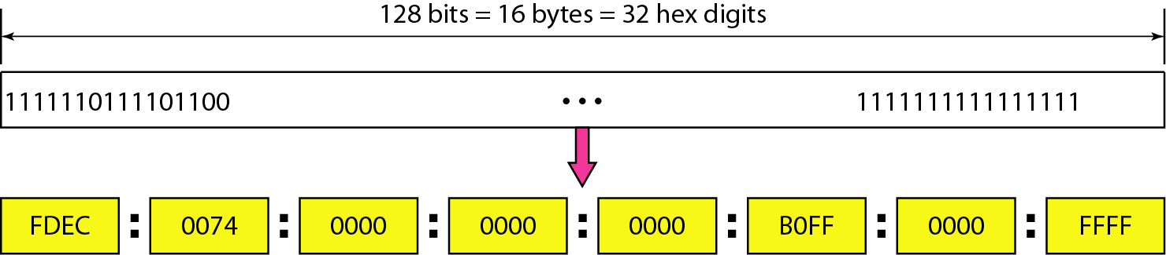
Figure 19.14 IPv6 address in binary and hexadecimal colon notation

Slide 32
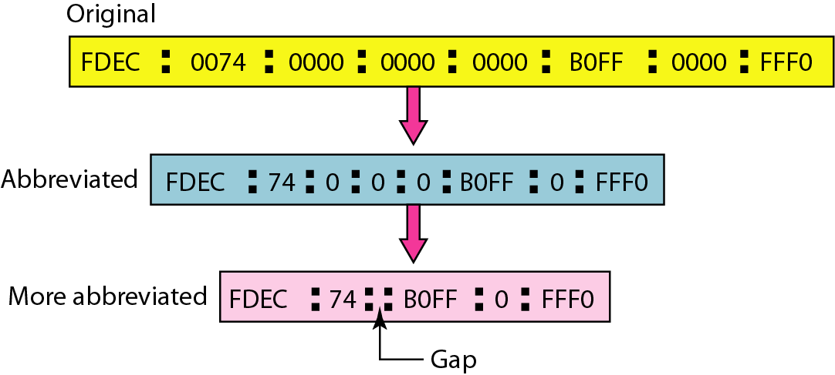
Figure 19.15 Abbreviated IPv6 addresses

Slide 33
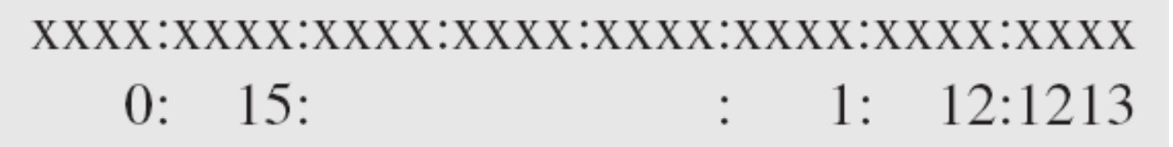
Example 19.11
Expand the address 0:15::1:12:1213 to its original.
Solution
We first need to align the left side of the double colon to the left of the original pattern and the right side of the double colon to the right of the original pattern to find how many 0s we need to replace the double colon.
This means that the original address is.

Slide 34
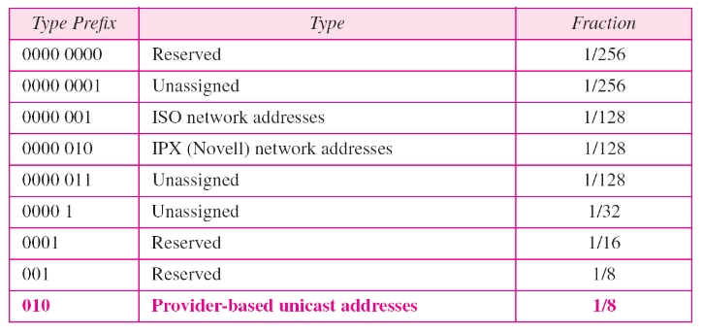
Table 19.5 Type prefixes for IPv6 addresses

Slide 35
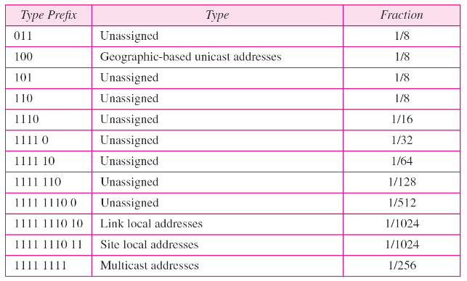
Table 19.5 Type prefixes for IPv6 addresses (continued)

Slide 36
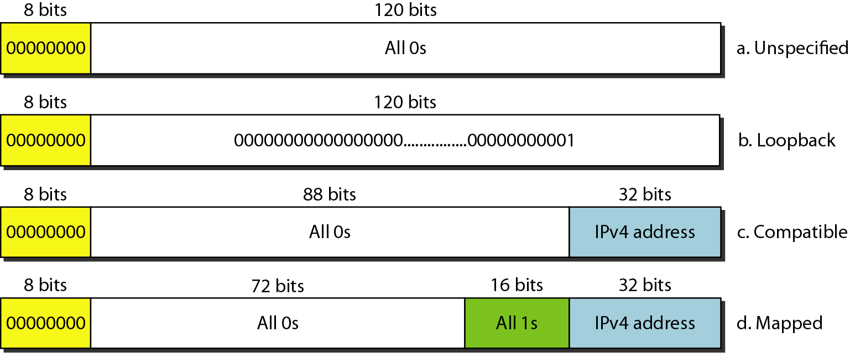
Figure 19.18 Reserved addresses in IPv6

Slide 37
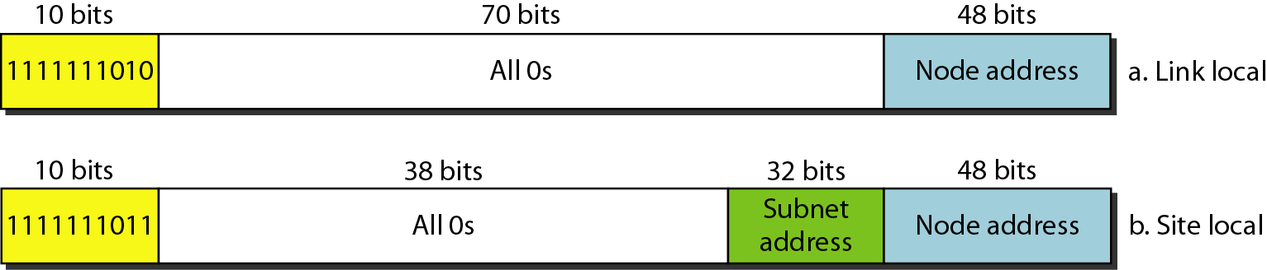
Figure 19.19 Local addresses in IPv6

